Slide 1
Electrostatic Charge

Slide 2
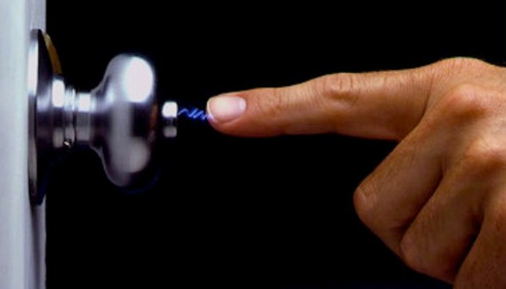
Learning Objectives
CFU
What are we going to learn?
Define electrostatic charge
Describe how electrostatic charge is produced.
Activate Prior Knowledge
Have you ever experienced a small shock from “static electricity”?
Think-pair-share: When have you experienced this?
Turn to your partner and share your experiences.
What might be causing this shock?

Slide 3
Concept Development
CFU 1
Which subatomic particles are negatively charged?
Electrostatic Charge
Electric charge is either positive or negative.
Produced by subatomic particles
Electrons – negative
Protons – positive
Usually objects are uncharged, but when electrons move from one object to another (e.g. by rubbing together) it create:
An area of relatively positive charge (has lost electrons)
An area of relatively negative charge (has gained electrons)
We call this difference in charge – Electrostatic Charge
CFU 2
If an object loses electrons, does it become negatively or positively charged?
CFU 3
Think-pair-share: would an electrostatic charge exist between two uncharged particles?

Slide 4
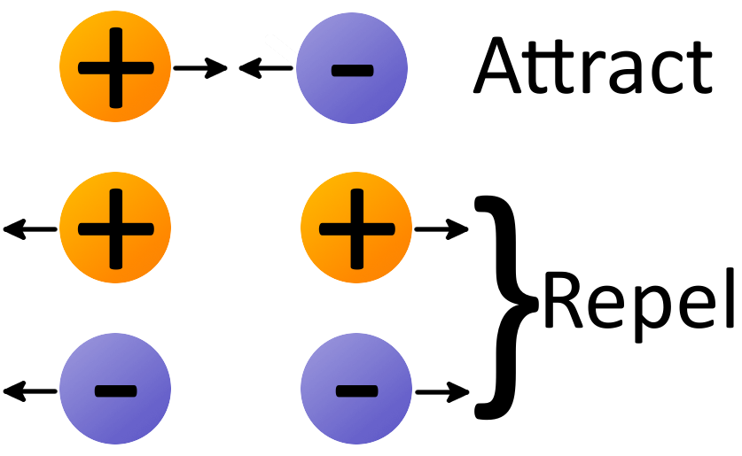
Concept Development
CFU 1
Name the force that exists between two or more charged particles?
Electrostatic Charge
When charged particles are near each other they apply an electrostatic force on each other.
Like charges repel
E.g. 2 positive particles push away from each other
Unlike charges attract
E.g. a positive particle and a negative pull towards each other
CFU 2
Describe how a negative and a positively charged particle behave when near each other?
CFU 3
Describe how two negatively charged particles would behave when near each other.
Vocabulary
Repel: force something to move away. Attract: to draw or pull together.

Slide 5
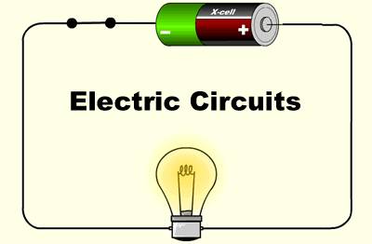
Concept Development
CFU 1
How is a closed circuit different to an open circuit?
Electrical Energy and Circuits
When electric charge become separated, they have electrical energy.
This means that positive and negative charge are trying to get back together again.
If the circuit is closed, the electrons will move along the wire to the positive charges.
Batteries use a chemical reaction to continually separate charges, and produce a current of electricity through wires.
We call a closed conducting pathway, an electrical circuit.
CFU 2
How do batteries produce a continuous current?
Vocabulary
Closed circuit: a complete electrical connection. Open circuit: an incomplete electrical connection.

Slide 6
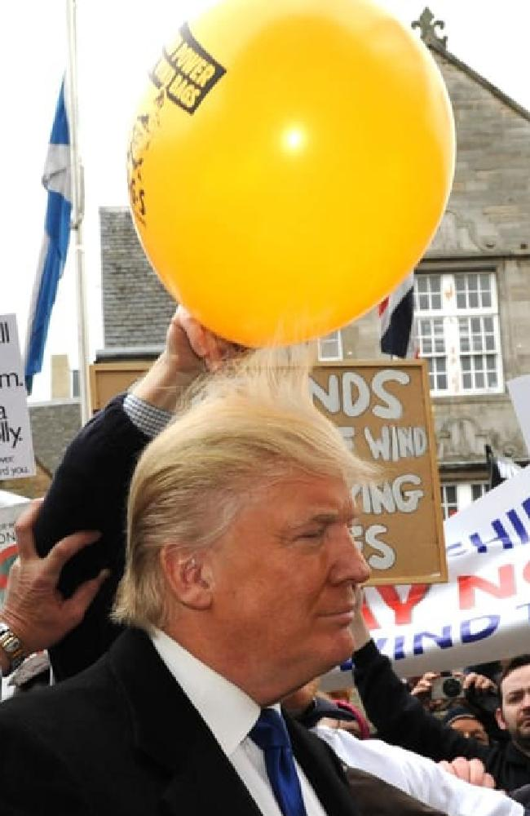
Skill Development/Guided Practice
CFU 1
Which two objects are interacting?
Explaining Electrostatic Charge
State the two objects that are interacting. State which object is gaining electrons. State the relative charge of each object.
CFU 2
Which object is gaining electrons?
As a balloon is rubbed against your hair, the electrons from the hair are transferred to the balloon. Describe the Electrostatic charge of each object.
CFU 3
What are the relative charges of the objects?
The hair and the balloon are exchanging electrons. The electrons are moving from the hair to the balloon. The balloon is now relatively negative, and the hair is relatively positive.
CFU 4
Think-pair-share: Why is the hair sticking to the balloon?

Slide 7
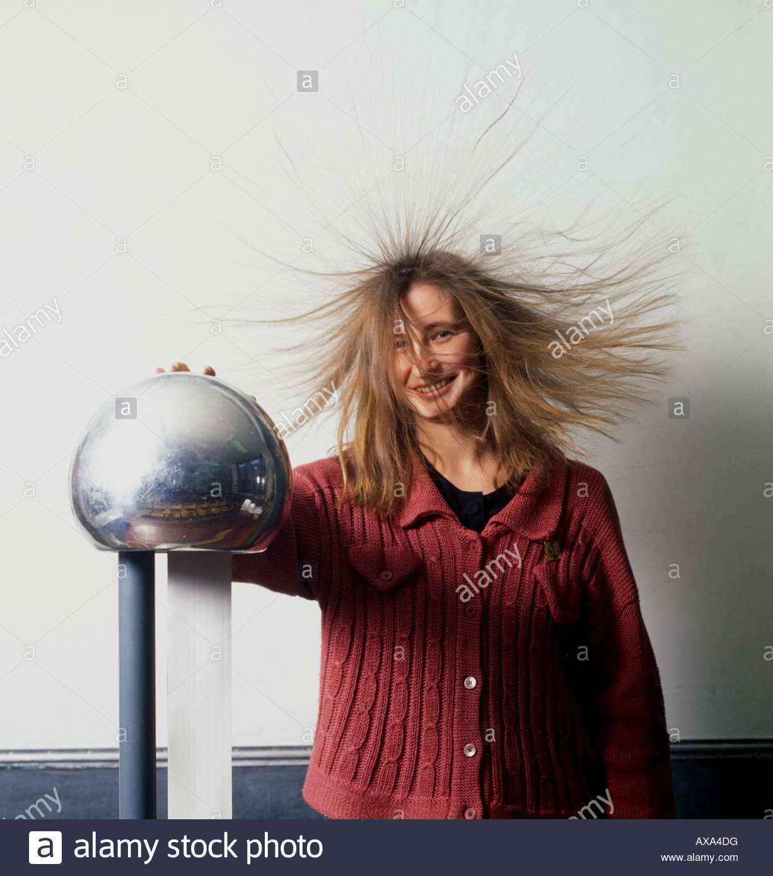
Skill Development/Guided Practice
CFU 1
Which two objects are interacting?
Explaining Electrostatic Charge
State the two objects that are interacting. State which object is gaining electrons. State the relative charge of each object.
CFU 2
Which object is gaining electrons?
The Van De Graaf generator has a rubber band inside it that is moving electrons from the metal dome, to the lady’s hair.
CFU 3
What are the relative charges of the objects?
The ____ and the _____ are exchanging electrons. The electrons are moving from the _____ to the ______. The ______ is now relatively negative, and the _____ is relatively positive.
CFU 4
Think-pair-share: Why is the hair standing on end and spreading out?

Slide 8
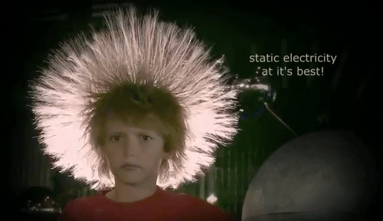

Slide 9
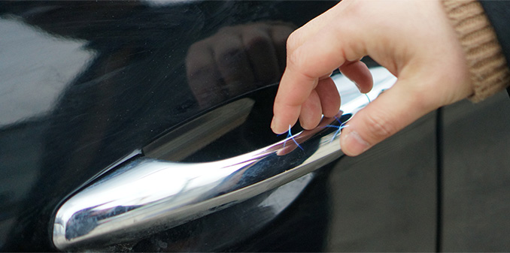
Skill Development/Guided Practice
CFU 1
Which two objects are interacting?
Explaining Electrostatic Charge
State the two objects that are interacting. State which object is gaining electrons. State the relative charge of each object.
CFU 2
Which object is gaining electrons?
As you drive in a car, you are gently rubbing on the seat and gaining electrons. When you get out and go to close the door you get a zap.
In your own words, describe the electrostatic charge of each object.
CFU 3
What are the relative charges of the objects?

Slide 10

Relevance
Electrostatic charge is a key concept in understanding how electrical current is produced in a circuit.
Static electricity can explain a lot of phenomena that you experience in day to day life.
Getting zapped by your car door
Getting zapped by your trampoline
Zapping your friends after walking on carpet in socks
Lightning!

Slide 11
Skill Closure
Protons have a positive charge, electrons have a negative charge. Describe how these particles would behave when close to one another.
Skill Closure
How is a closed electrical circuit different to an open electrical circuit?
Skill Closure
When the hair of this boy becomes electrostatically charged, it stands on end and spreads out. In your own words, explain why the hair does this.

Slide 12
Kahoots
Complete the Electricity and Charge worksheet on connect or paper copy.
https://create.kahoot.it/details/c945ee8a-aaf8-4749-a85b-962f9be67098
https://create.kahoot.it/share/duplicate-of-miss-foster-9-electrical-circuit-symbols/cda242bf-9d80-4a54-a849-1be63da71116

